Slide 1


Web Development
Week 7
Abertay
abertay.ac.uk

Slide 2
Today's topics
Multiple database tables
Storing Images
Search Bar
Dom Effects
Adding Video
Graceful Degradation and Progressive Enhancement

Slide 3
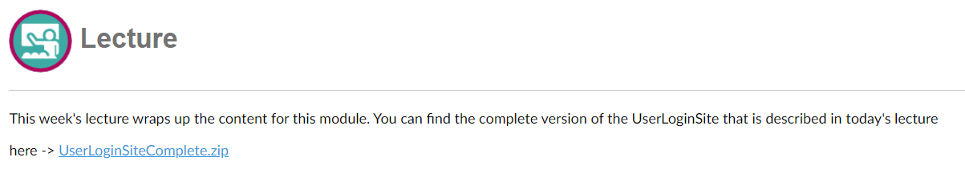
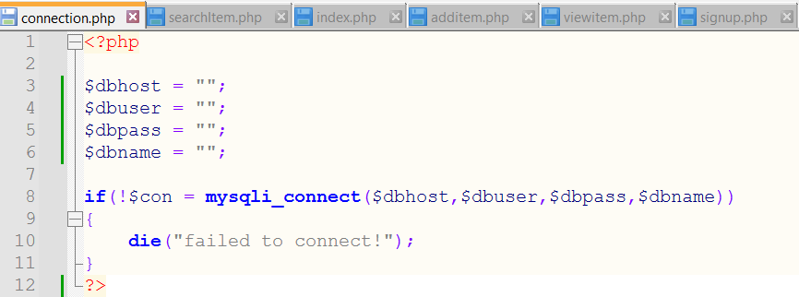
Files Provided

Slide 4
Multiple Database Tables
Abertay
abertay.ac.uk

Slide 5
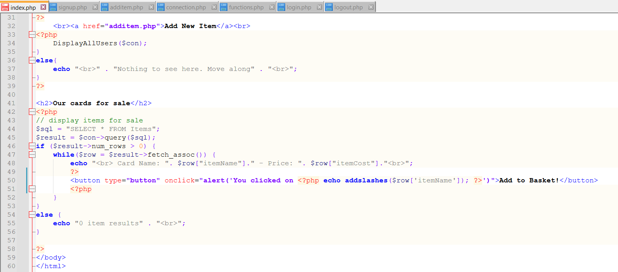
Multiple database tables

Slide 6
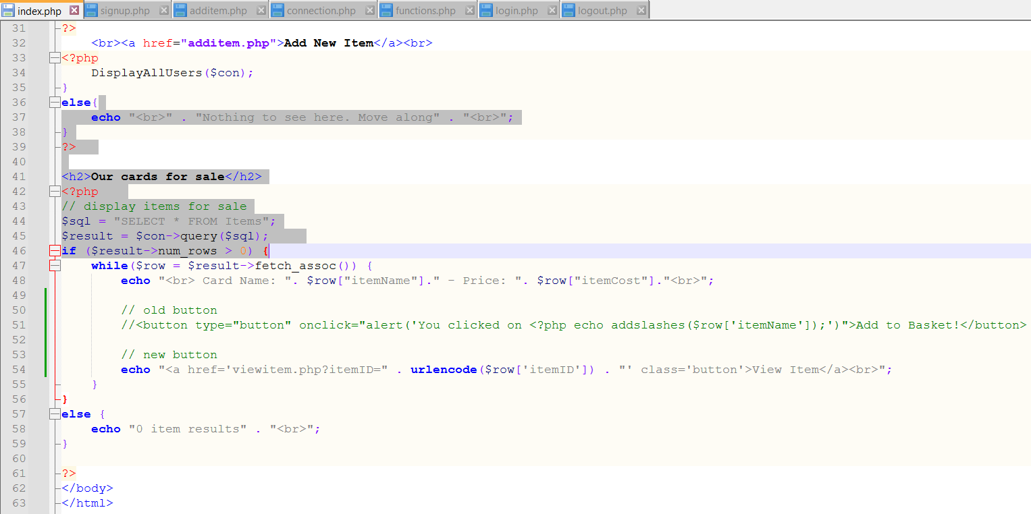
Multiple database tables

Slide 7
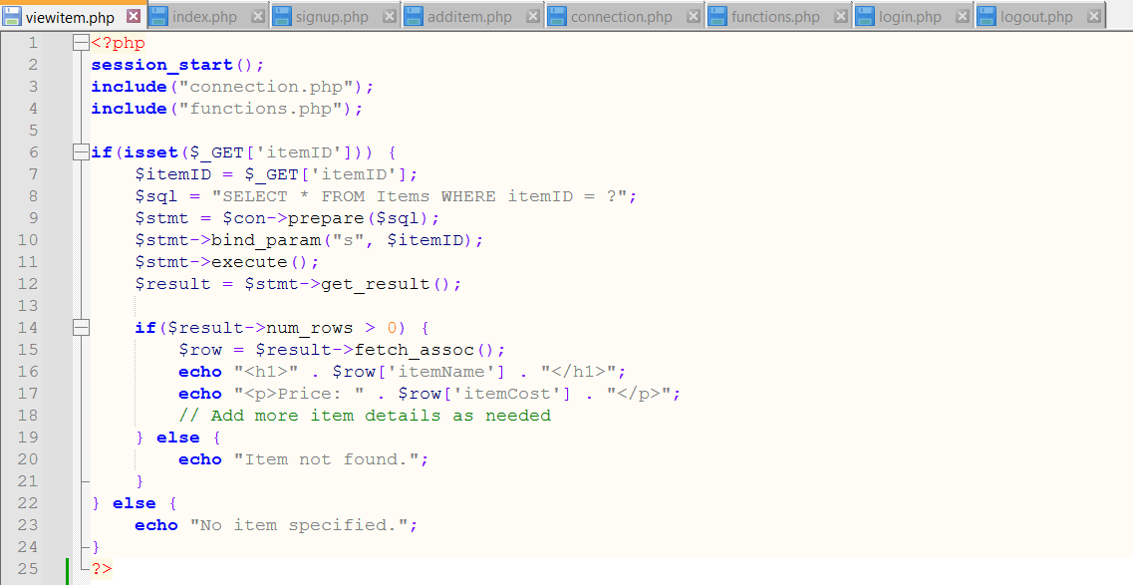
Multiple database tables

Slide 8
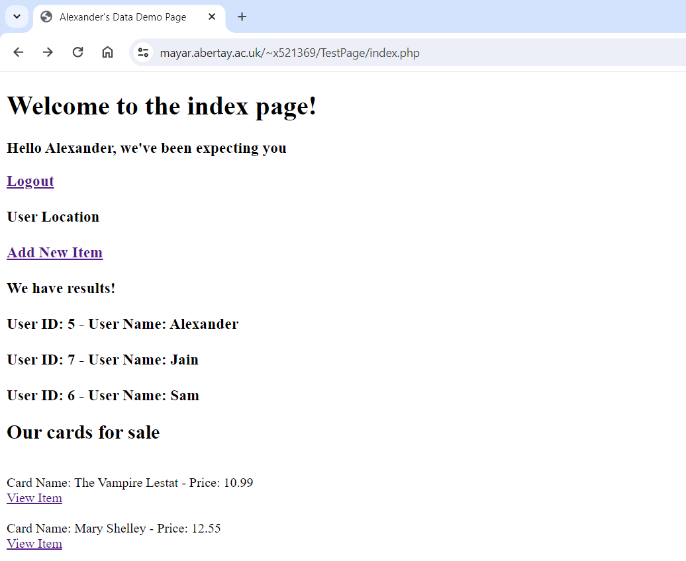
Multiple database tables

Slide 9
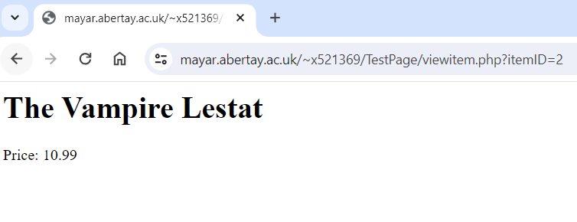
Multiple database tables

Slide 10
Storing Images
Abertay
abertay.ac.uk

Slide 11
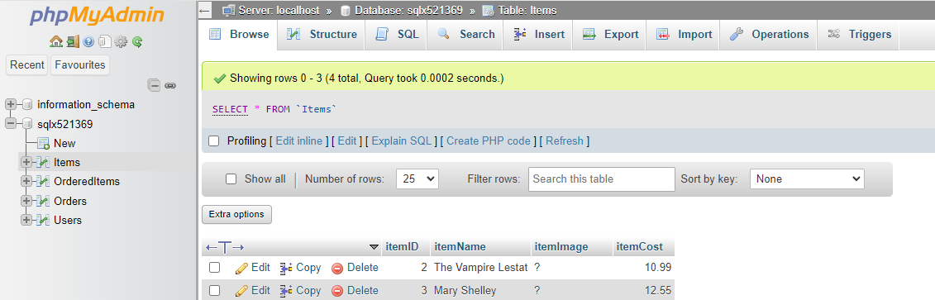
Storing Images

Slide 12
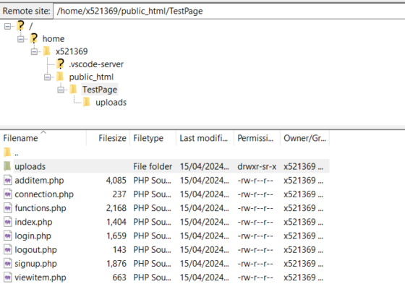
Storing Images – server permissions

Slide 13
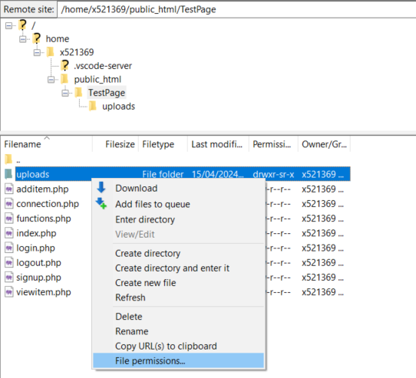
Storing Images

Slide 14
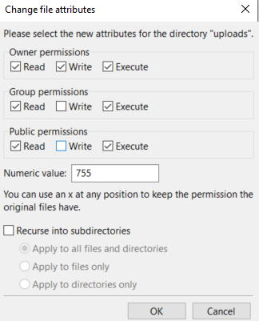
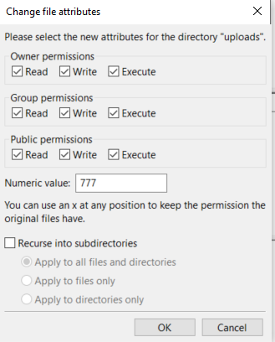
Storing Images

Slide 15
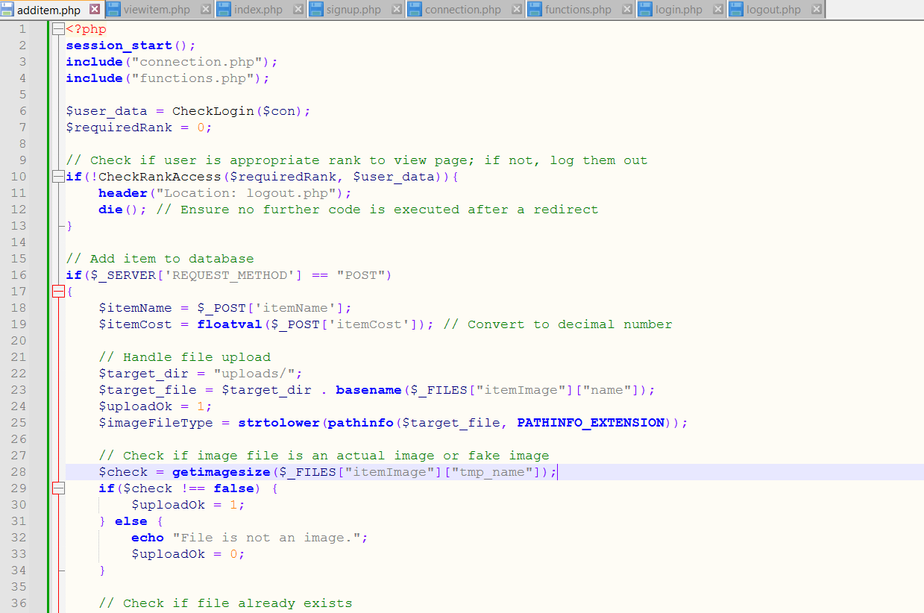
Storing Images – Update to additem

Slide 16
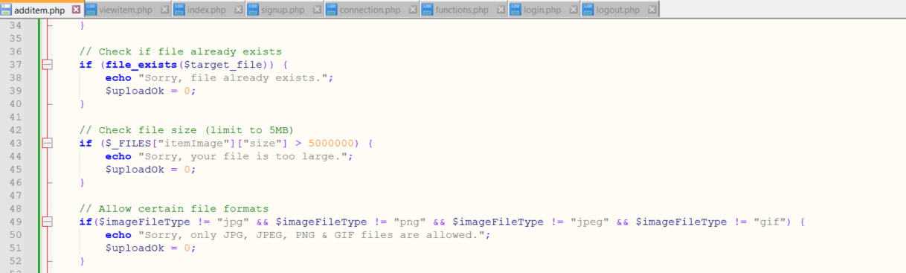
Storing Images

Slide 17
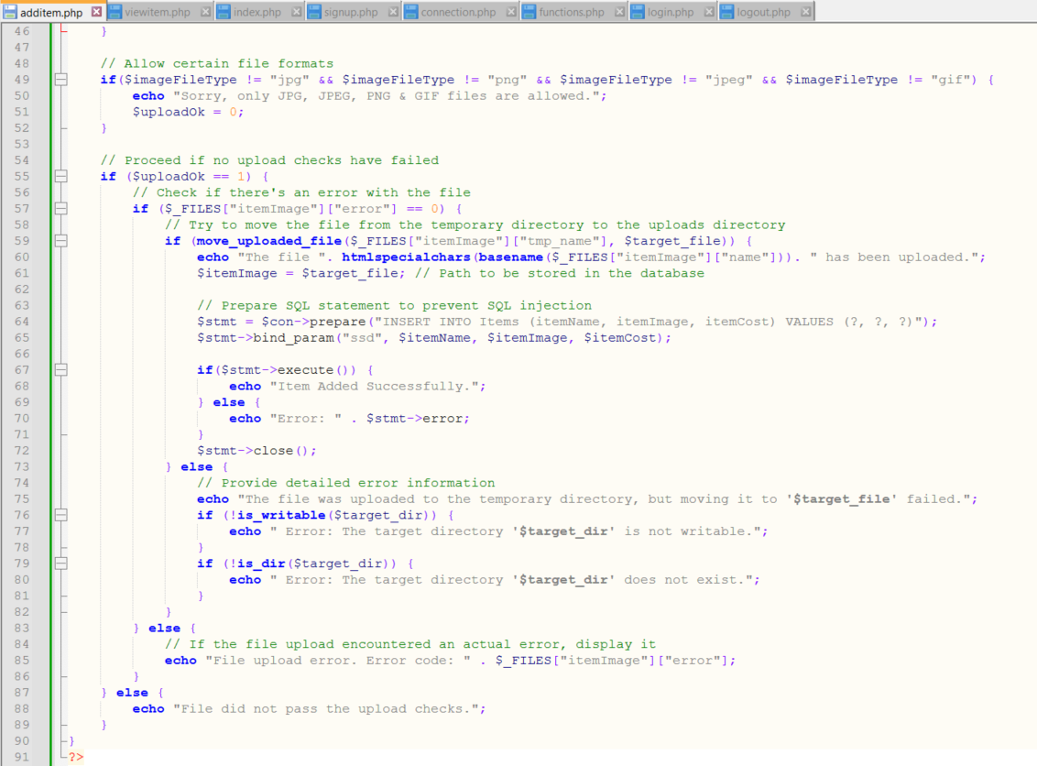
Storing Images

Slide 18
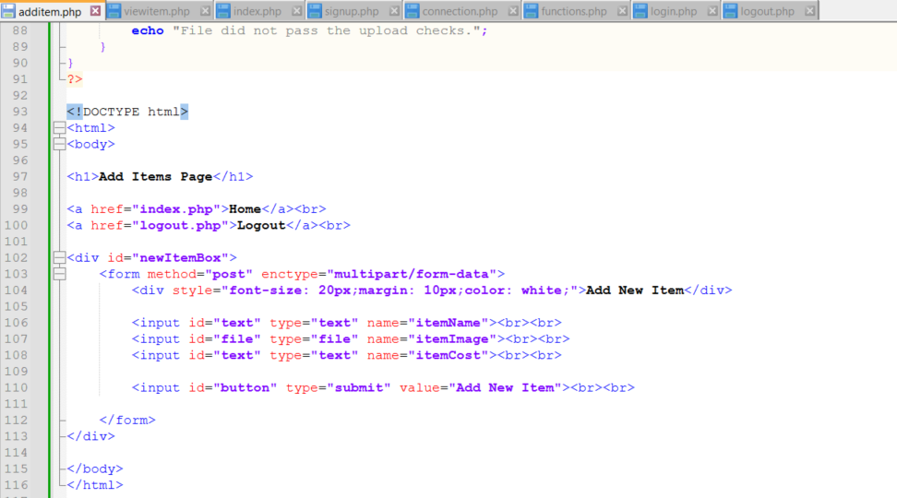
Storing Images

Slide 19
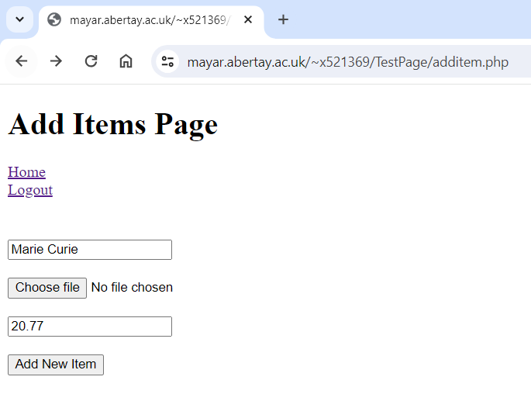
Storing Images

Slide 20
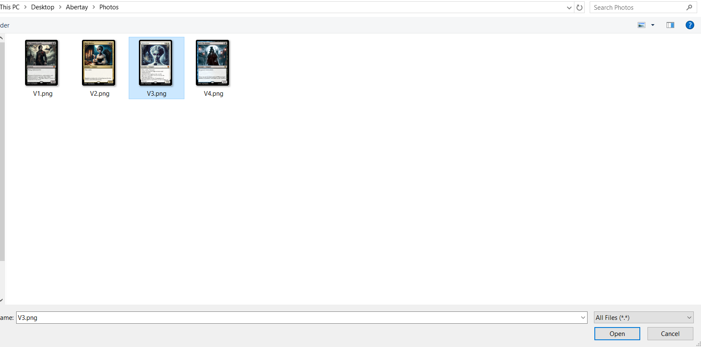
Storing Images

Slide 21
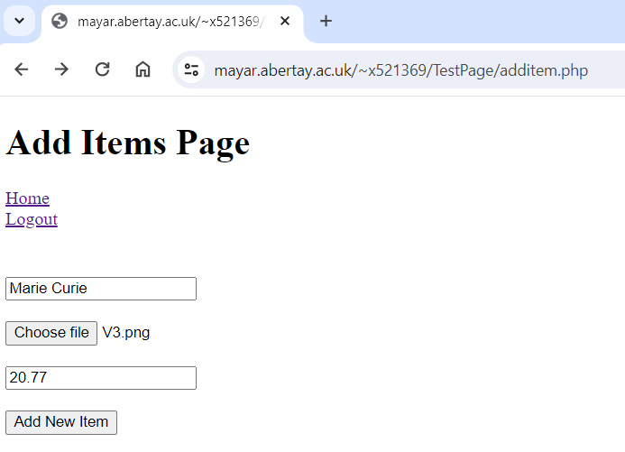
Storing Images

Slide 22
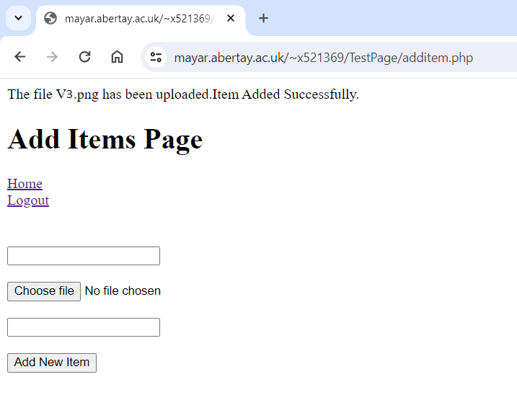
Storing Images

Slide 23
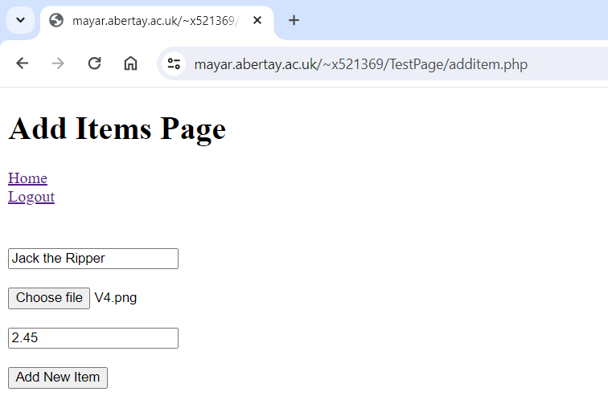
Storing Images

Slide 24

Storing Images

Slide 25
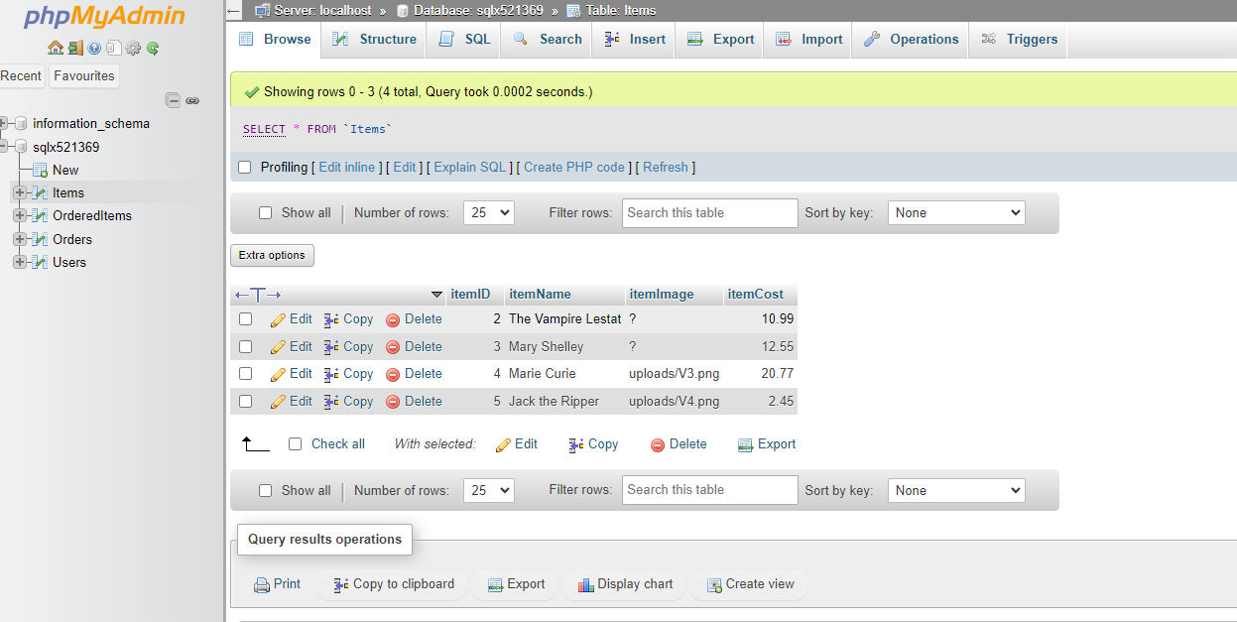
Storing Images

Slide 26
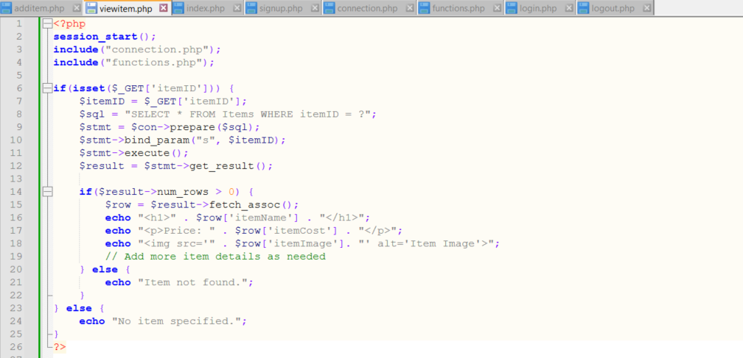
Storing Images

Slide 27
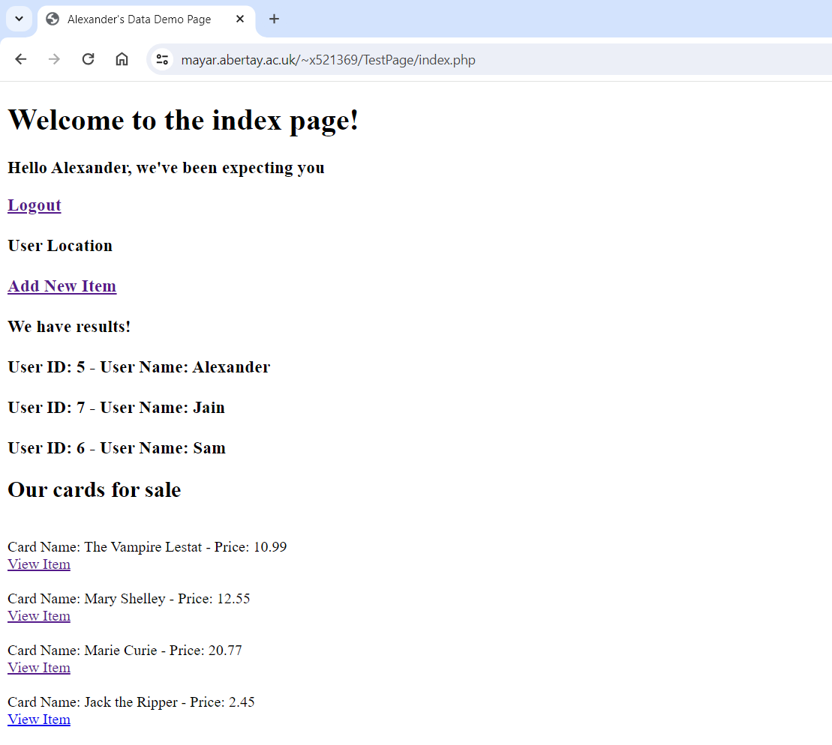
Storing Images

Slide 28
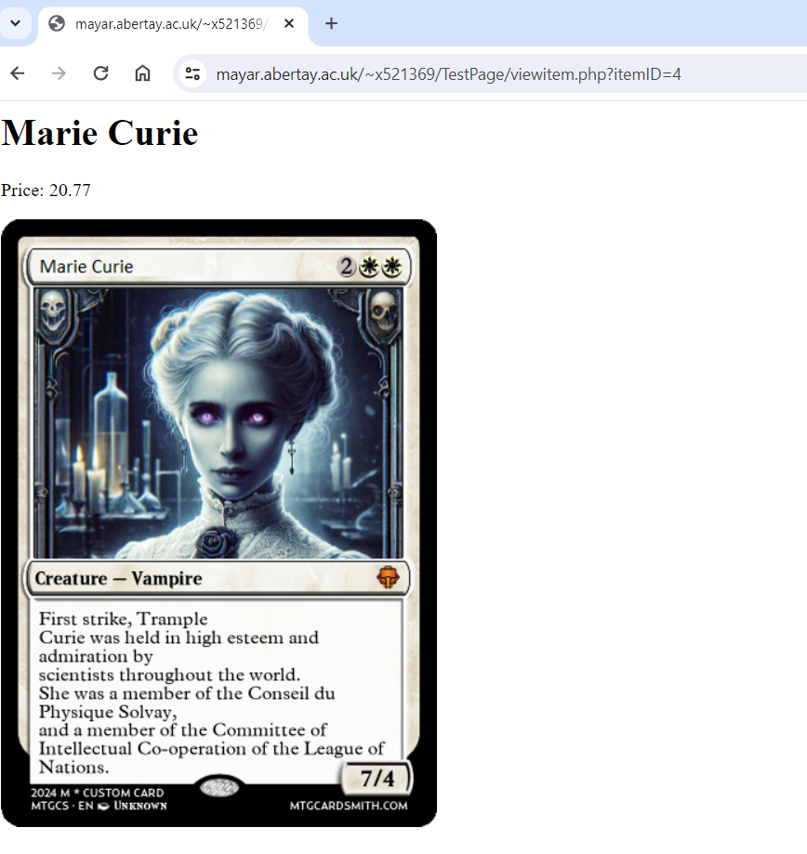
Storing Images

Slide 29
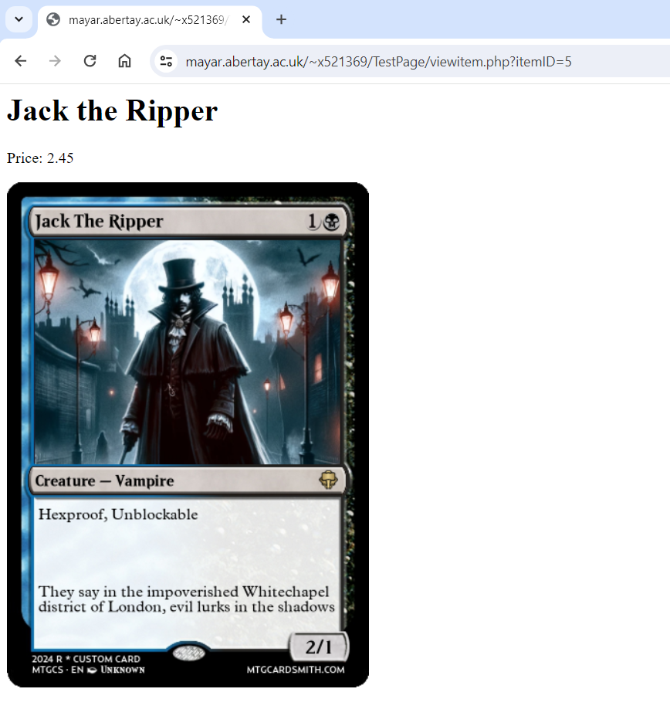
Storing Images

Slide 30
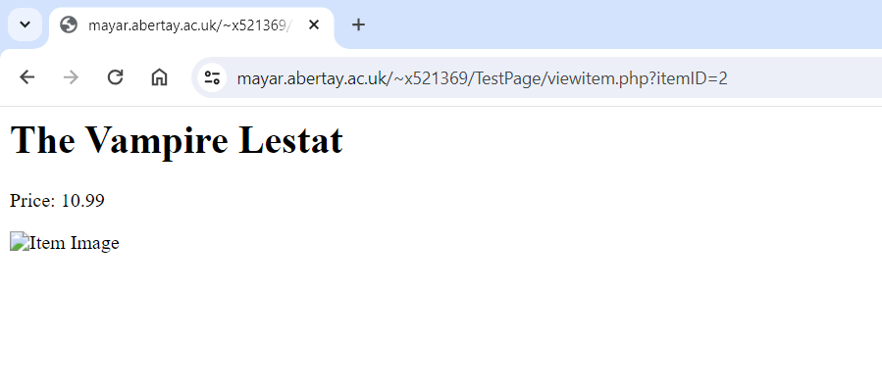
Storing Images

Slide 31
Search Bar
Abertay
abertay.ac.uk

Slide 32
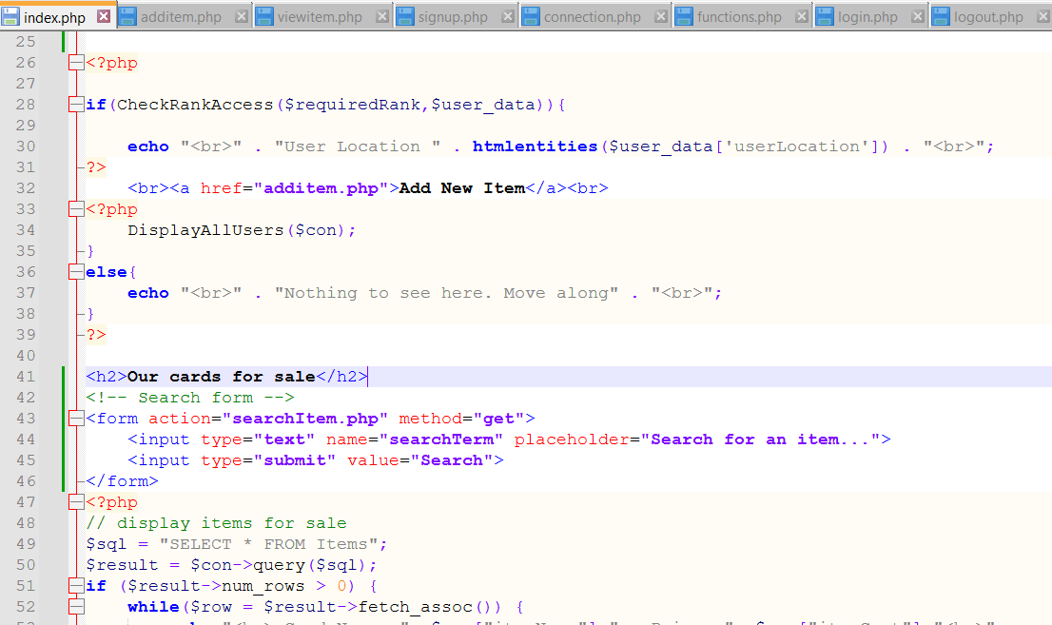
Search Bar

Slide 33
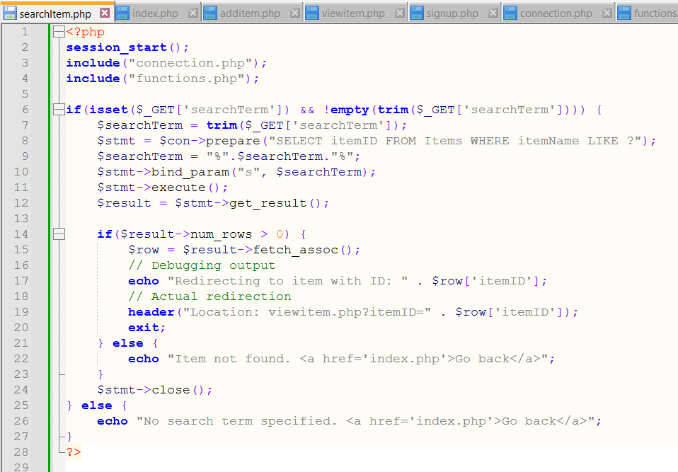
Search Bar

Slide 34
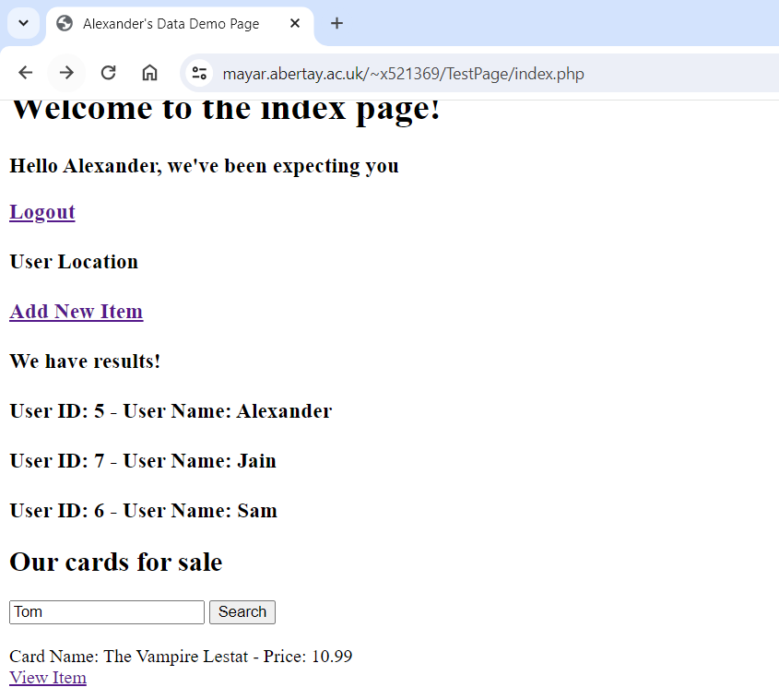
Search Bar

Slide 35
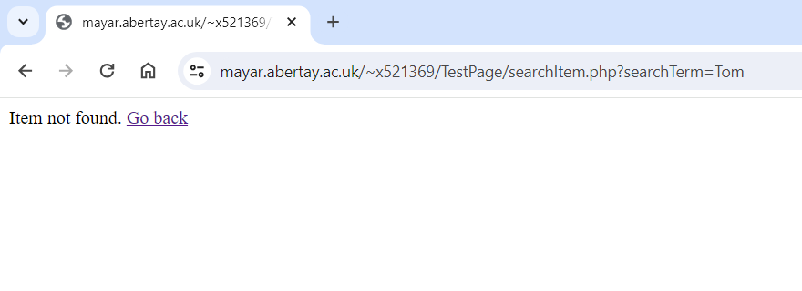
Search Bar

Slide 36
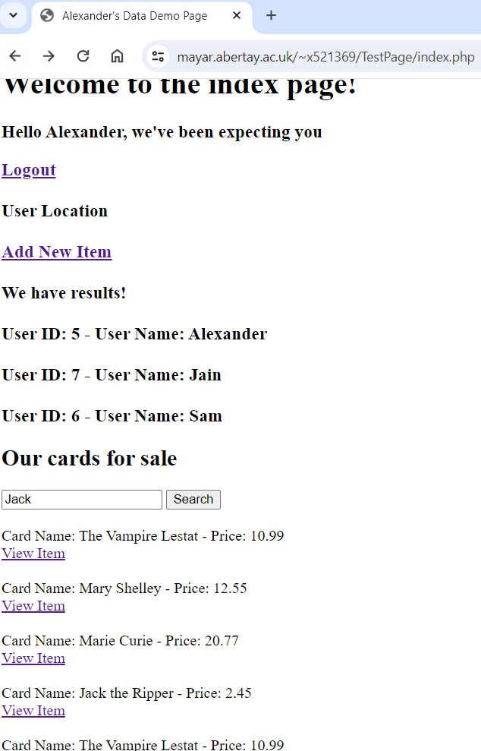
Search Bar

Slide 37
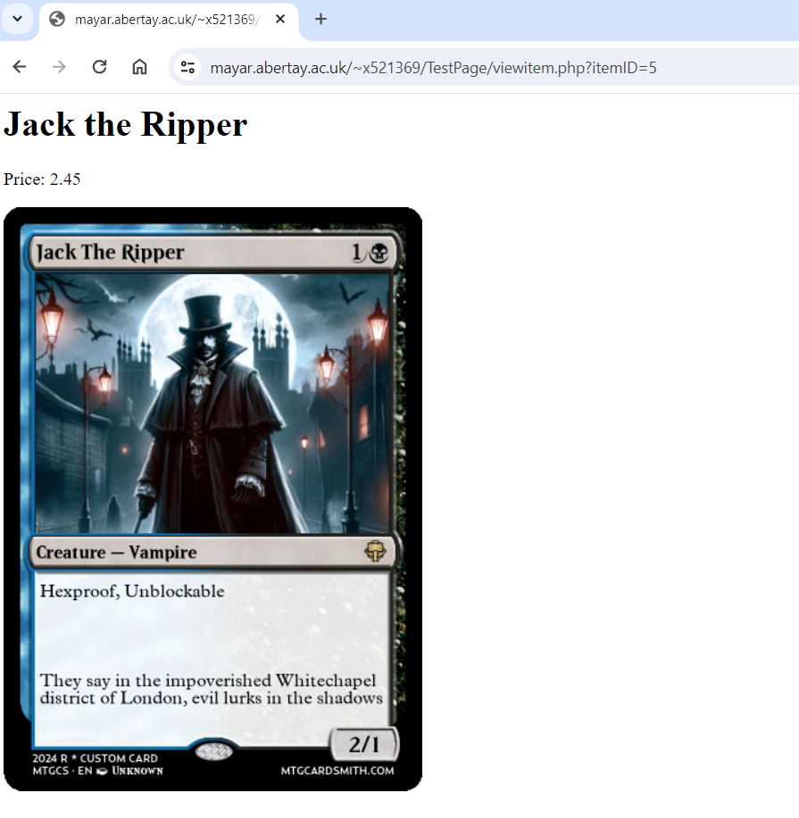
Search Bar

Slide 38
Dom Effects UP/DOWN Voting System
Abertay
abertay.ac.uk

Slide 39
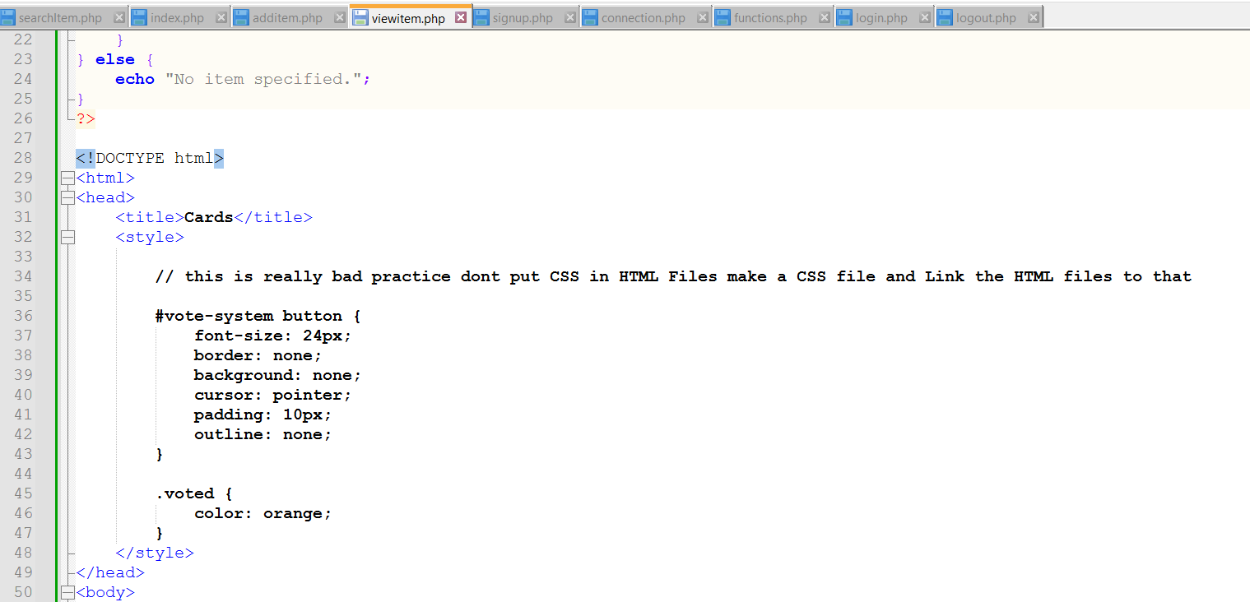
DOM Effects

Slide 40
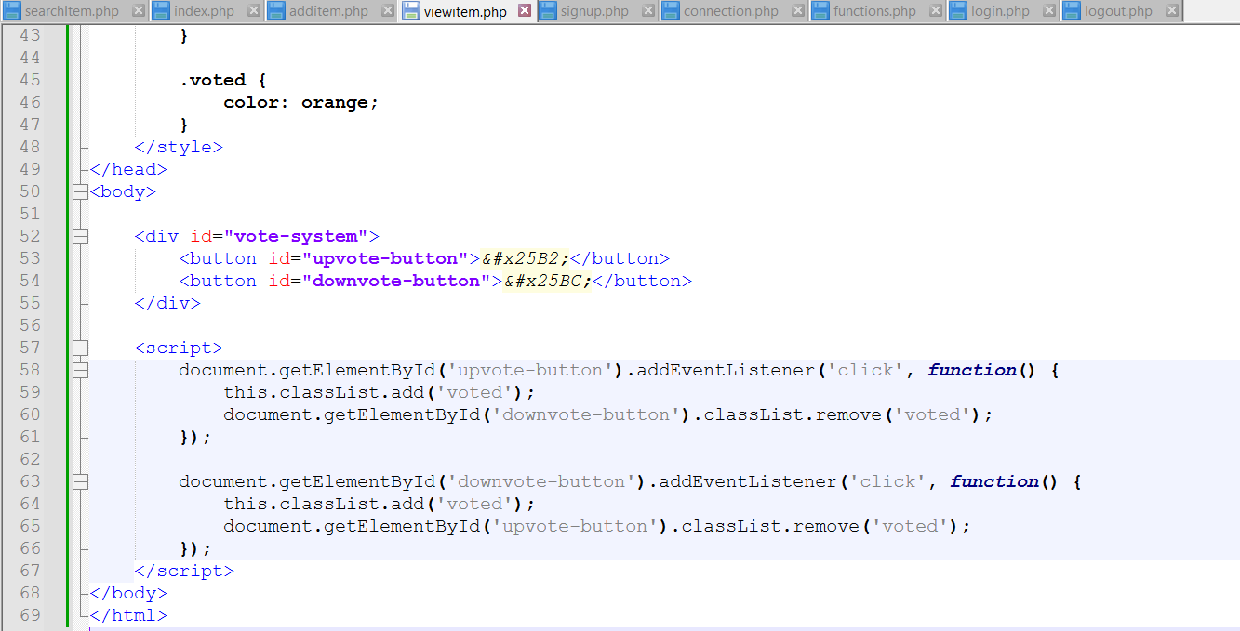
DOM Effects

Slide 41
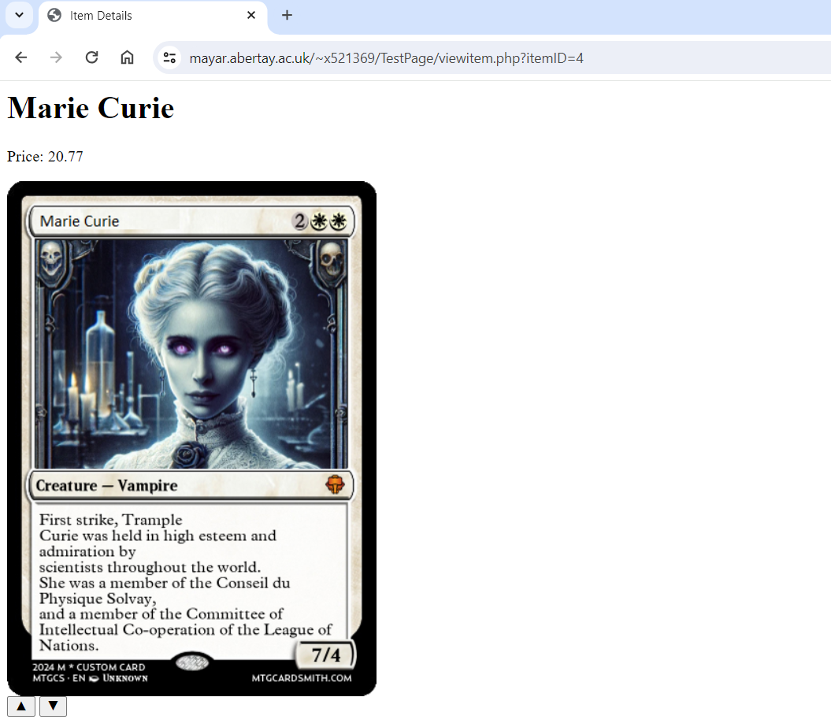
DOM Effects

Slide 42
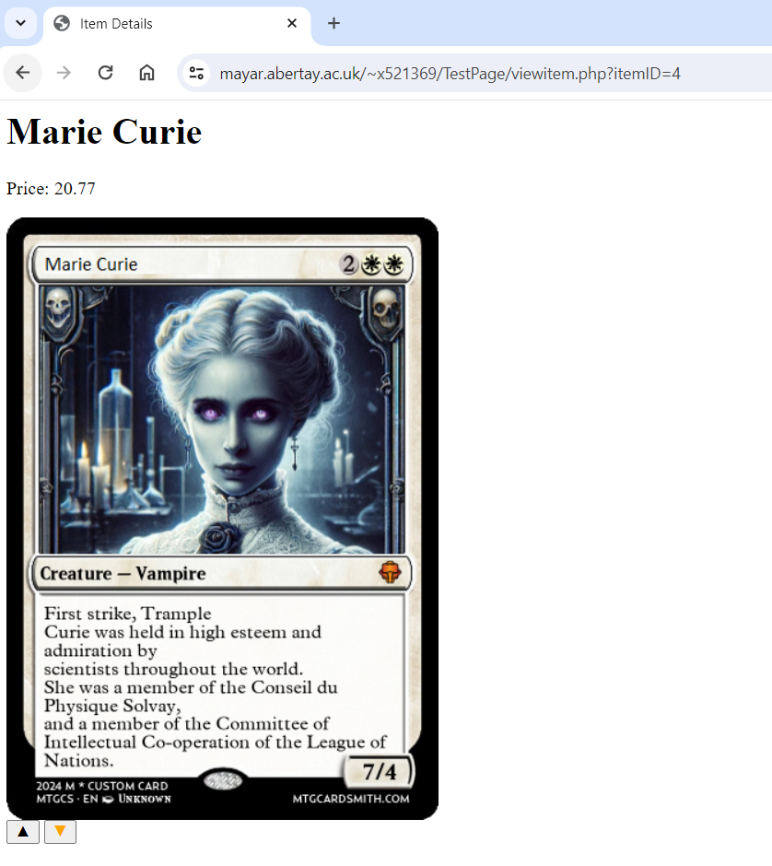
DOM Effects

Slide 43
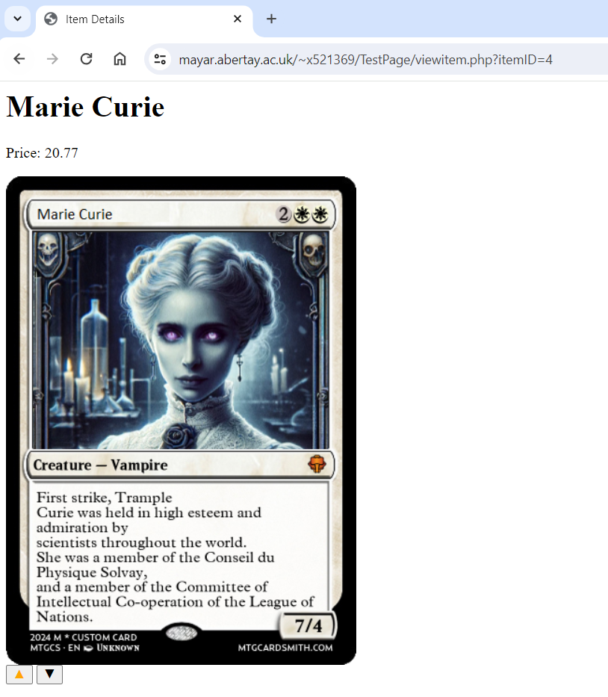
DOM Effects

Slide 44
DOM Effects
JavaScript HTML DOM Animation
https://www.w3schools.com/js/js_htmldom_animate.asp

Slide 45
Video
Abertay
abertay.ac.uk

Slide 46
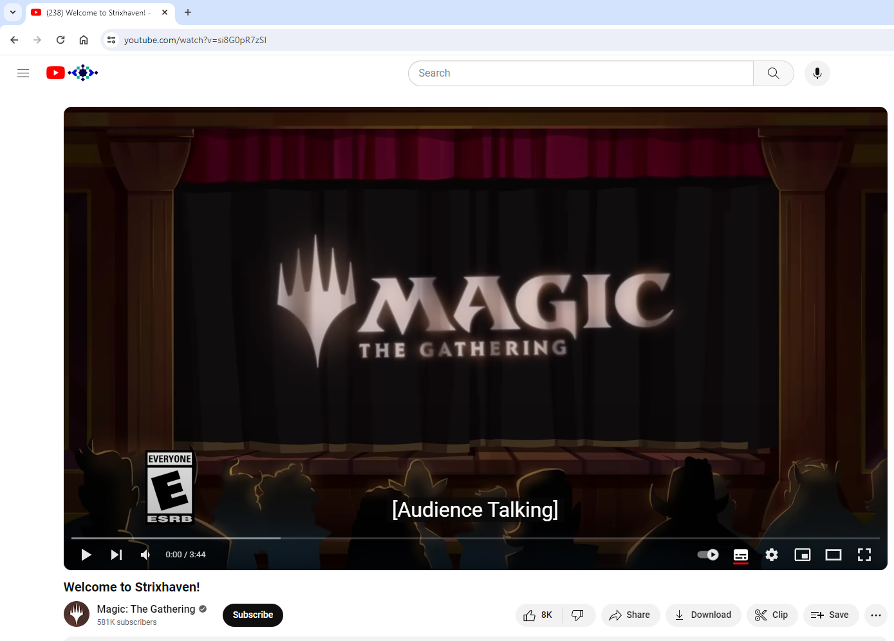
Video
https://www.youtube.com/watch?v=si8G0pR7zSI

Slide 47
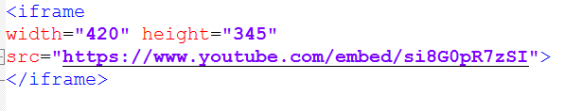
Video

Slide 48
Video
https://www.youtube.com/embed/
+
https://www.youtube.com/watch?v=si8G0pR7zSI
=

Slide 49
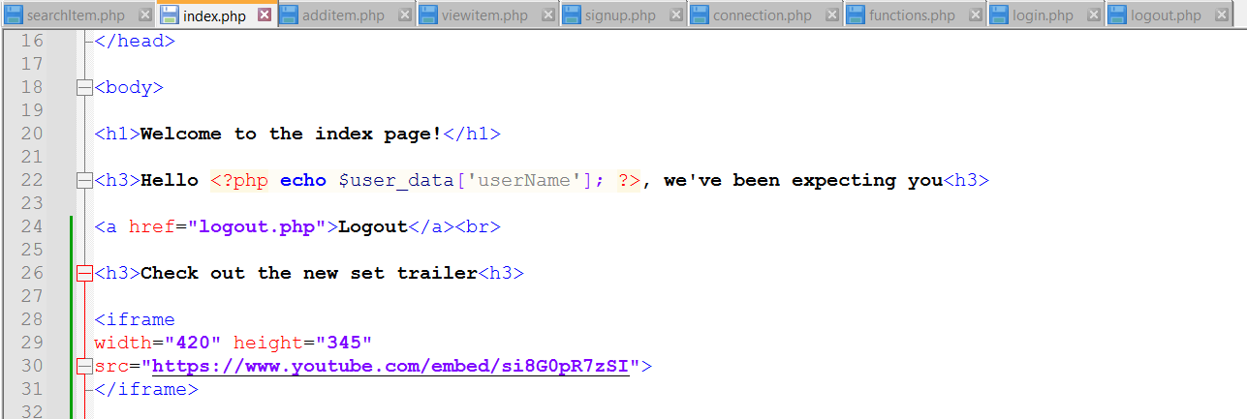
Video

Slide 50
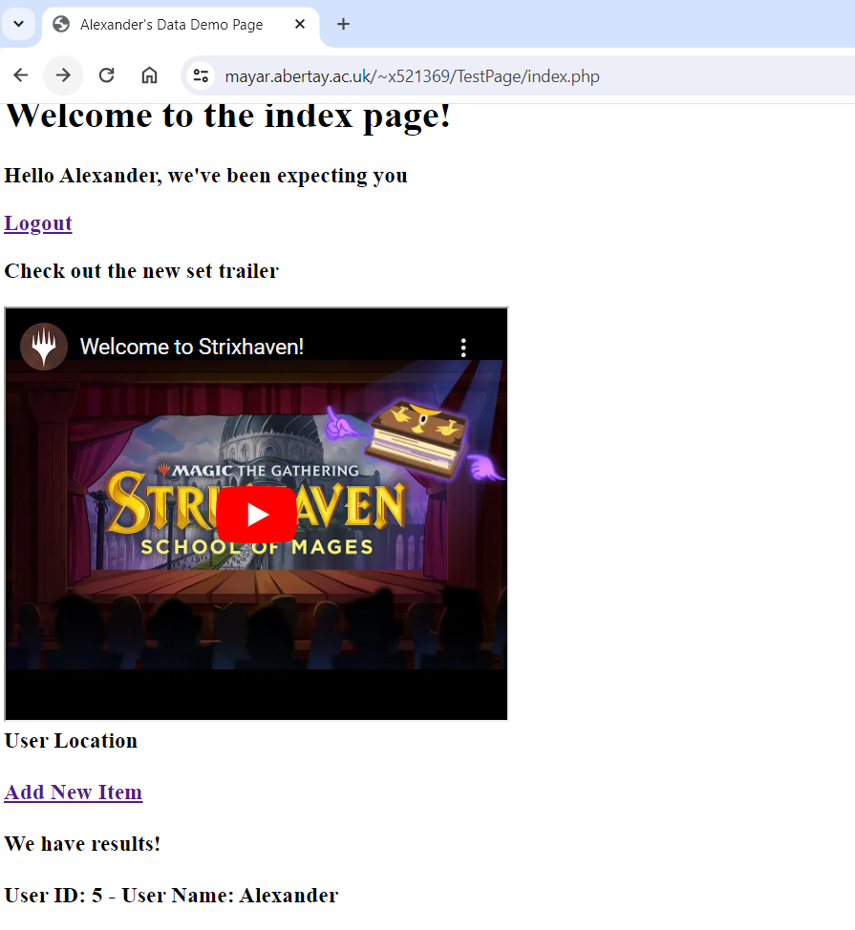
Video

Slide 51
Video
HTML YouTube Videos
https://www.w3schools.com/html/html_youtube.asp

Slide 52
Graceful Degradation and Progressive Enhancement
Abertay
abertay.ac.uk

Slide 53
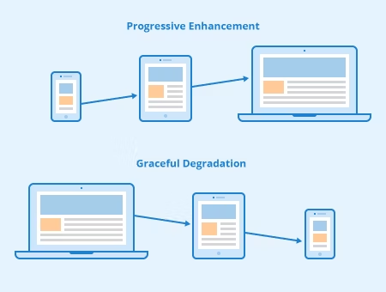

Slide 54
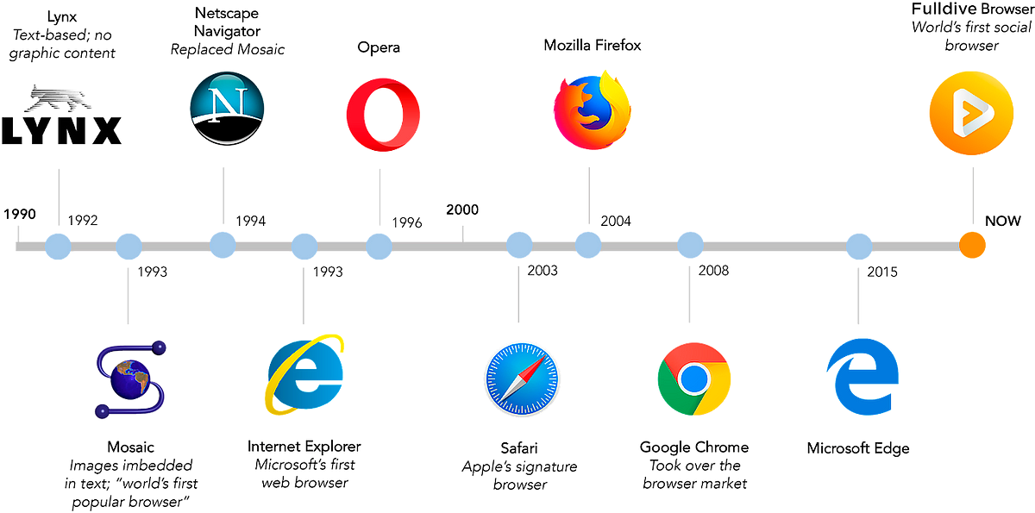

Slide 55
Thank You
Abertay
abertay.ac.uk

